Slide 1
Flutter App with Back4App for Database Operations and User Authentication 2024tm93170 Venkata Neha Avalur

Slide 2
Agenda
Architecture of the Solution 3
Working of User Authentication 4
Database Structure 5
Tools Used 6
Challenges 7
GitHub Link 8
Demo 9

Slide 3
Solution Architecture
The solution consists of two main components:
Frontend: Built using Flutter, a cross-platform UI toolkit, to provide a seamless user experience across Android and iOS devices.
Backend: Powered by Back4App, a backend-as-a-service (BaaS) platform based on Parse Server, which handles data storage, user authentication, and server-side logic.
The frontend communicates with the backend via REST APIs or the Parse SDK, enabling real-time data synchronization and user management.

Slide 4
User Authentication with Back4App
User authentication in Back4App is managed using the Parse User class. The process typically involves:
User Registration: Users sign up by providing a username, password and email. The data is securely stored in the User table. final user = ParseUser('username', 'password', 'email@example.com'); var response = await user.signUp(); User Login: Users log in with their credentials, and a session token is generated for subsequent requests. final user = ParseUser('username', 'password', null); var response = await user.login(); Session Management: The session token is used to authenticate API requests, ensuring secure access to user-specific data.

Slide 5
Database Structure on Back4App
The database structure is based on Parse's schema-less design, allowing dynamic creation of classes and fields. Common tables include:
User: Stores user credentials and profile information.
Custom Classes: Application-specific data, such as:
Name: For user-generated content.
Age: For storing comments on posts.
Email: For tracking user interactions.
Each table supports relational data, ACL (Access Control List), and real-time updates

Slide 6
Tools Used
Frontend:
Flutter: For building the cross-platform UI.
Dart: The programming language used with Flutter.
Backend:
Back4App: For backend services and database management.
Parse SDK: For integrating Flutter with Back4App.
Development Tools:
Visual Studio Code: For code editing.
Postman: For testing API endpoints.
Git: For version control.

Slide 7
Key Challenges and Solutions
Challenge: Managing real-time data updates.
Solution: Leveraged Parse's live query feature to enable real-time updates in the app.
Challenge: Debugging API integration issues.
Solution: Used tools like Postman and Flutter's debugging features to identify and resolve issues quickly.
Challenge: Calling Back4App DB created previously instead of createing new DB or calling wrong uri
Solution: Browsed through documentation of back4app and various projects to understand to call just the api not the classes/assignmentclass

Slide 8
GitHub Links
Code Link
https://github.com/neha200/Cross-Platform-Application-Assignment
Video Link
https://youtu.be/mNvL-iParZE

Slide 9
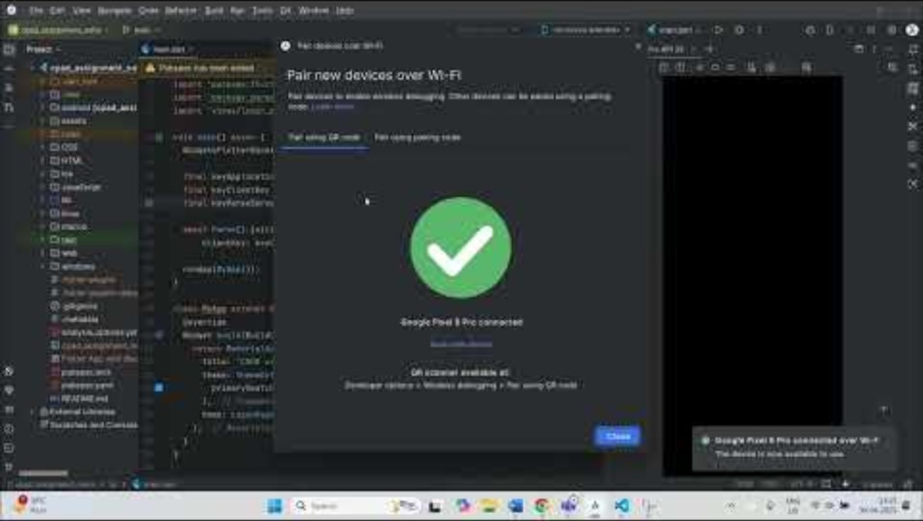
Demo Video

Slide 10
Thank You
Venkata Neha Avalur
2024tm93170
2024tm93170 @wilp.bits-pilani.ac.in

